Slide 1
Department of Veterans Affairs
Develop ICDs for TAS-FSC transaction interfaces jointly between TAS-CORE and the FSC
1/5/2018
V1.0

Slide 2
Agenda
Introductions (Glen lead and use the resource/product matrix for context)
Previous Meeting Action Items (Glen)
Purpose of ICD collaboration between MCCF and FSC teams (Tony)
Goals and timelines (Tony)
Team Structure
Transaction List
Acceptance Criteria for TAS Core
Proposed Approach (Tony)
Next Steps and Action Items (Tony)
Questions

Slide 3
Previous Meeting Action Items
MCCF - Will provide a preliminary table this afternoon (Glen)
FSC - Jai will provide the name against the table (Jai/Rey)
MCCF can provide the Build schedule for the 837.
eBilling Build 7 (6/11/18 - 8/31/18). ICDs will be needed in advance.
MCCF has user stories in the current build which takes us out to 3/9/18.
Goal is to complete ICDs by 3/9/18.
Set up follow-on meeting with all POCs to set up the working process. Evaluate holiday capacity. (Glen)
Jai would like a weekly touchpoint meeting for scrum team progress (Mike/Tony/Rey)
Send revised list of transactions to Jai/Rey (Glen/Mike)

Slide 4
Purpose of ICD Collaborations
The purpose of the ICD Collaborations is to understand and develop Interface Control Documents that will allow for development and interfacing between the TAS CORE platform and the FSC.

Slide 5
Goals and Time Lines (9 Weeks)
01/05/2018
Define a Design for the Interface
Determine Initial Transaction(s) for ICD Development
Review/Define Structure of ICD
Discuss Bundles and JSON
01/12/2018
Define Initial Bundles for Messages to FSC
Define Bundles for Messages to TAS CORE
01/19/2018
Continue Definition of Message Bundles
01/26/2018
Continue Definition of Message Bundles
02/02/2018
Start construction of Documentation
02/09/2018
Continue Construction of Documents
02/16/2018
Continue Construction of Documents
02/23/2018
Continue Construction of Documents
03/02/2018
Begin Review of Documents
03/09/2018
ICD Deliveries

Slide 6
ICD Development Team Structures
Role | TASCore | eBilling | eInsurance | ePharmacy | ePayments
Transactions | Interface and Shared Components NPI Extracts NIF Messages MDA Report | 837I 837P 837D 278-215 278-217 275 276 277RFAI, CA, STAT | 270 271 | NCPDP B1 B2 E1 | 835 (EFT, ERA, MRA) CCD+
MCCF Dev Project Manager | AJ Delisle | Sharon Taubenfeld | Tony Barazza | Sharon Taubenfeld | Tony Barazza
MCCF ICD Primary POC | Tony Howard | Steffen Maerdian | Steffen Maerdian | Steffen Maerdian | Steffen Maerdian
MCCF ICD Secondary POC | Mike Cordi | Keith Oulson | Keith Oulson | Keith Oulson | Keith Oulson
MCCF PMO Functional Analyst | Kim Battles | Anne DeBacker | Rebecca Russell | Cindy Fawcett | Robert Fecteau
MCCF Product Team Dev Lead | Tony Howard | William Jutzi | Darlene White | Mark Dawson | Fred Altman
MCCF Developer | Steffen Maerdian, Keith Oulson | John Smith | Tim Zimmer | Paul Devine | Peter Hartley
FSC PM | Rey Ablaya | Rey Ablaya | Rey Ablaya | Rey Ablaya | Rey Ablaya
FSC Primary POC | Jimmy Medrano | James Maldonado | Pranav Shah | Amit Malhotra | Aaris Epps
FSC Secondary POC | Sowjanya Vakkalanka | Jimmy Medrano | Amit Malhotra | Pranav Shah | Sowjanya Vakkalanka

Slide 7
Transaction Listing
TasCore | eBilling | eInsurance | ePharmacy | ePayments
Interface and Shared Components NPI Extracts NIF Messages MDA Report | 837I 837P 837D 278-215 278-217 275 276 277RFAI, CA, STAT | 270 271 | NCPDP B1 B2 E1 | 835 (EFT, ERA, MRA) CCD+
Notes:
837 I,P,D as one document
278-215, 278-217 as one docoument

Slide 8
Acceptance Criteria for ICD’s
Scope and sequence of ICD Development is determined with the FSC including the X12 versions will be developed
Verify that one or more ICDs for following TAS-FSC transaction have been developed jointly with FSC
835I (Institutional 835)
CCD+ (Cash concentration or disbursement)
E1
837D (837 Dental)
837P (837 Professional)
837I (837 Institutional)
278-215 (Healthcare service review inquiry and response)
278-217 (Healthcare services request for review and response)
277RFAI (Request for additional information)
277CA (Claim acknowledgment)
276
275 (Additional Information to Support a Health Care Claim or Encounter)
275 (Additional Information to Support a Healthcare Service Review)
Validate that mappings in the ICDs are consistent with previously designed mappings (see dependencies). If there are mapping discrepancies, verify that previous mapping documentation has been reconciled.
Process for ICD development is determined with FSC, including where work in progress and final work will be stored.

Slide 9
Proposed Approach
Determine which transaction we start with or possibly assign to multiple sub-groups to work that may be the most efficient
Discuss layout and format of the transactions
Document structure of the ICD
Review the current ICD's and what can be reused.
Review of JSON and initial payload structure;

Slide 10
Next Steps and Action Items

Slide 11
Questions

Slide 12
Backup

Slide 13
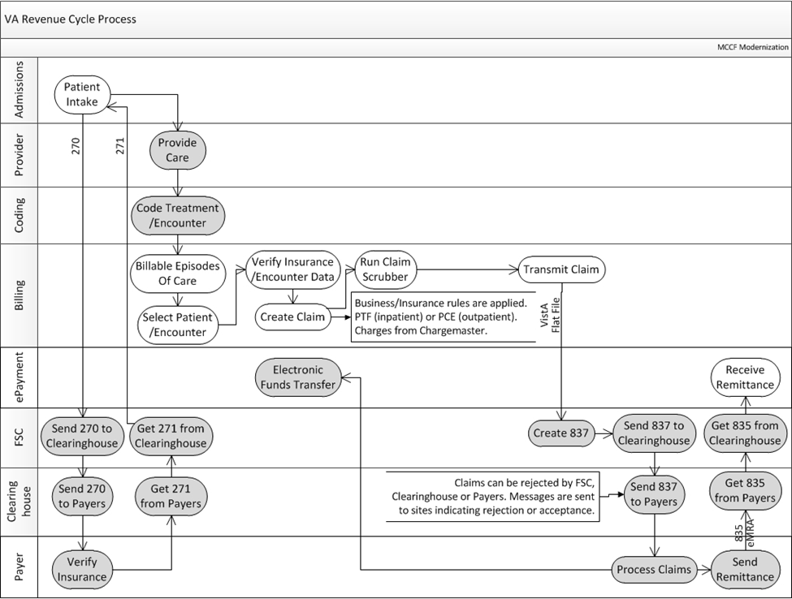
Business Processing

Slide 14
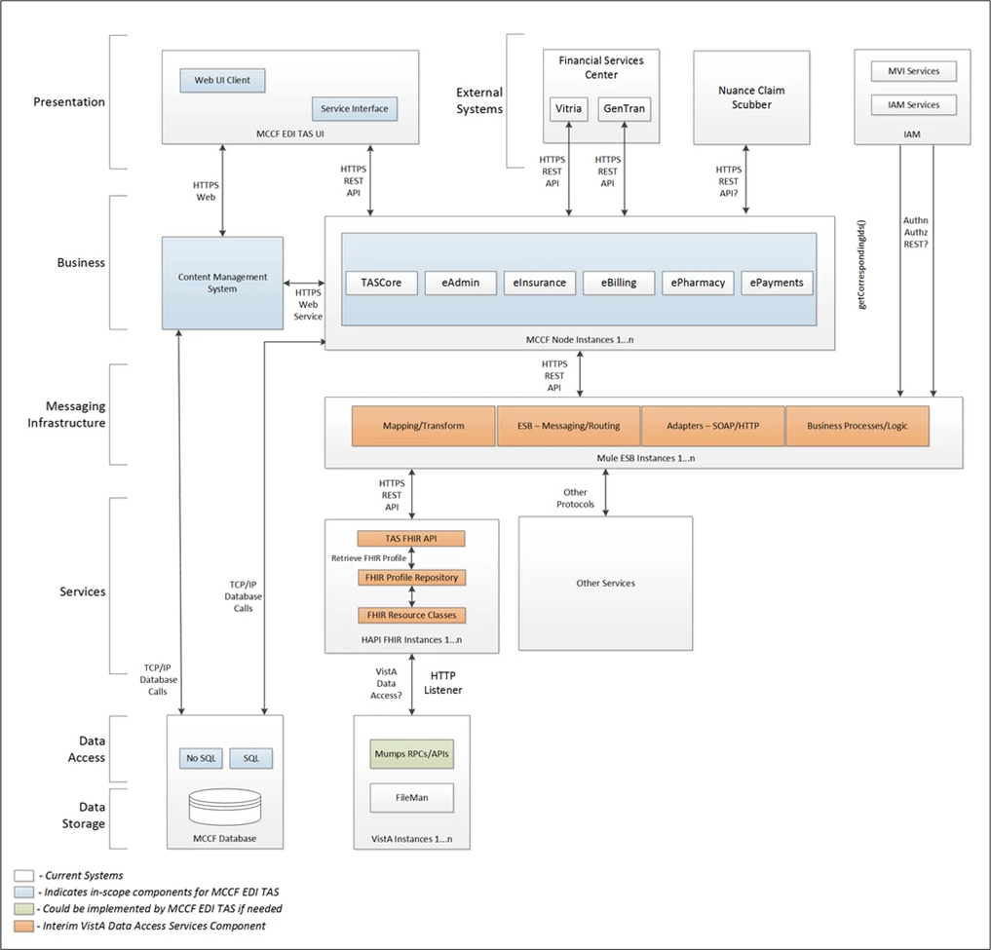
TASCore Architecture

Slide 15
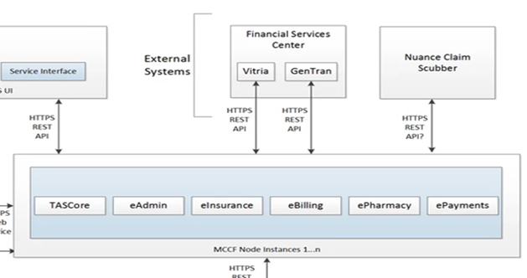
TAS Core FSC Interface

Slide 16
ICD Layout (Section 1)
Purpose
Scope
System Identification
Operational Agreement

Slide 17
ICD Layout (Section 2)
Interface Definition
System Overview
Overview Diagram
Interface Overview
Connectivity between the systems
Operations
Data Extraction
Data Transformation
Sending/Receiving
Data Transfer
Data is transferred between the FSC and the TAS Core Application Stack
Transaction Types
Defined for Each ICD

Slide 18
ICD Layout (Section 2)
Data Exchanges
FHIR Based Resources
JSON Format
Bundle Definition
Communication Methods
HTTP(S)
Ports and Protocols
ESB Configuration(s)
System Configuration
Performance Requirements
Security
Is within the VA Firewall
Testing Requirements
Comparison of Data
Completeness
Policies and Constraints
HIPAA Compliance

Slide 19
ICD Layout (Appendix A)
Data Elements
Bundle Header
Resource Sections 1..N
Embedded spreadsheet with the following columns:
Element #
Max Length
FSC Transaction Location
FSC Comments
FHIR Resource
TAS Core Comments

Slide 20
ICD Layout (Appendix B) TAS Core Mapping Rules
Examples:

Slide 21
ICD Layout (Appendix C) TAS Core Default Values
Examples:

Slide 22
ICD Layout (Appendix D) FSC Mapping Rules
Examples:
TPA Clearinghouse ID
Site Focus Testing
Payer ID Switch
Set X12 Outbound Claim Version
Remove NPI from Medicare Claims
Remove AB3
Remove LQ
Remove AAA
Remove 2U
Default Service Facility Address
Default Billing Address
Modify Secondary ID’s for Medicare Claims
Remove Other Payer Information from Claim
Remove Secondary ID’s from Claims
Compare Subscriber and Patient
Swap Address Lines

Slide 23
ICD Layout (Appendix E) FSC Default Values
Examples:
Field Name | Institutional Location | Professional Location | Value
Information source | BHT01 | BHT01 | 0019
Original transaction | BHT02 | BHT02 | 00
Transaction type | BHT06 | BHT06 | CH
Submitter name qualifier | NM101 | NM101 | 41
Submitter name type | NM102 | NM102 | 2
Submitter name | NM103 | NM103 | DEPT VETERANS AFFAIRS
Submitter ID qualifier | NM108 | NM108 | 46
Submitter ID | NM109 | NM109 | 741612229
Submitter contact qualifier | PER01 | PER01 | IC

Slide 24
TAS CORE
FSC
835i
835i
CCD+
CCD+
E1
E1
837I
837I
AITC
837P
837P
837D
837D
278-215
278-215
278-217
278-217
277RFAI
277RFAI
277CA
277CA
276
276
275 HCCE
275 HCCE
275 HCSR
275HCSR
Notes:
Alternate Processing (Connectivity) Beyond AITC
Express Route from Mag into the AITC
What is our common design.

Slide 25
FHIR RESOURCES
A-D
•Account 2
•ActivityDefinition 2
•AllergyIntolerance 3
•AdverseEvent 0
•Appointment 3
•AppointmentResponse 3
•AuditEvent 3
•Basic 1
•Binary 5
•BodySite 1
•Bundle 5
•CapabilityStatement 3
•CarePlan 2
•CareTeam 2
•ChargeItem 0
•Claim 2
•ClaimResponse 2
•ClinicalImpression 0
•CodeSystem 5
•Communication 2
•CommunicationRequest 2
•CompartmentDefinition 1
•Composition 2
•ConceptMap 3
•Condition (aka Problem) 3
•Consent 1
•Contract 1
•Coverage 2
•DataElement 1
•DetectedIssue 1
D-I:
•Device 2
•DeviceComponent 1
•DeviceMetric 1
•DeviceRequest 0
•DeviceUseStatement 0
•DiagnosticReport 3
•DocumentManifest 2
•DocumentReference 3
•EligibilityRequest 2
•EligibilityResponse 2
•Encounter 2
•Endpoint 2
•EnrollmentRequest 0
•EnrollmentResponse 0
•EpisodeOfCare 2
•ExpansionProfile 2
•ExplanationOfBenefit 2
•FamilyMemberHistory 2
•Flag 1
•Goal 2
•GraphDefinition 0
•Group 1
•GuidanceResponse 2
•HealthcareService 2
•ImagingManifest 1
•ImagingStudy 3
•Immunization 3
•ImmunizationRecommendation 1
•ImplementationGuide 1
I-P:
•Library 2
•Linkage 0
•List 1
•Location 3
•Measure 2
•MeasureReport 2
•Media 1
•Medication 3
•MedicationAdministration 2
•MedicationDispense 2
•MedicationRequest 3
•MedicationStatement 3
•MessageDefinition 0
•MessageHeader 3
•NamingSystem 1
•NutritionOrder 2
•Observation 5
•OperationDefinition 4
•OperationOutcome 5
•Organization 3
•Parameters 5
•Patient 5
•PaymentNotice 2
•PaymentReconciliation 2
•Person 2
•PlanDefinition 2
•Practitioner 3
•PractitionerRole 2
•Procedure 3
P-Z:
•ProcedureRequest 3
•ProcessRequest 2
•ProcessResponse 2
•Provenance 3
•Questionnaire 3
•QuestionnaireResponse 3
•ReferralRequest 1
•RelatedPerson 2
•RequestGroup 2
•ResearchStudy 0
•ResearchSubject 0
•RiskAssessment 1
•Schedule 3
•SearchParameter 3
•Sequence 1
•ServiceDefinition 0
•Slot 3
•Specimen 2
•StructureDefinition 5
•StructureMap 2
•Subscription 3
•Substance 2
•SupplyDelivery 1
•SupplyRequest 1
•Task 2
•TestScript 2
•TestReport 0
•ValueSet 5
•VisionPrescription 1

Slide 26
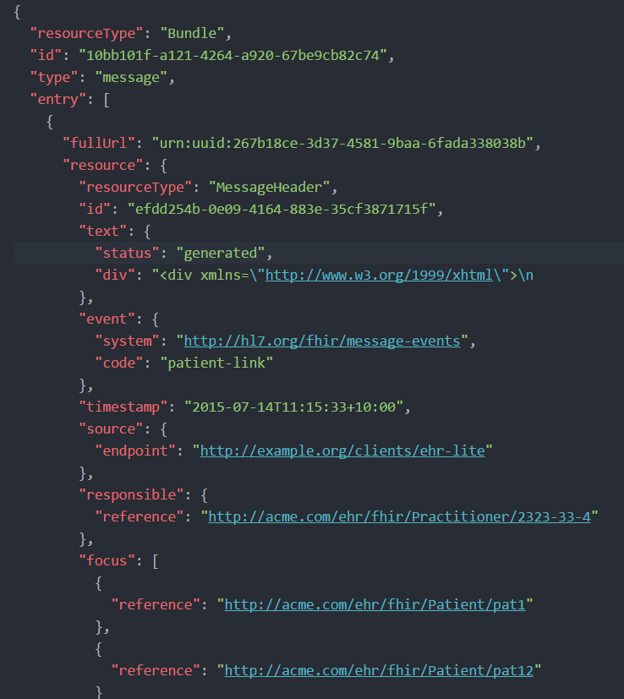
BUNDLE EXAMPLE

